Slide 1
ASSETLY
"REVOLUTIONIZING PERSONAL FINANCE THROUGH TECHNOLOGY"

Slide 2
OUR TEAM
Yash-Backend Developer & Database Architect
Bindusree-Frontend Developer & UI/UX Designer
Bhumika-Full-Stack Integration & API Specialist

Slide 3

ASSETLY: One Dashboard for All Investments
Multi-Asset Tracking: Stocks + gold in unified view
Real-Time Analytics: Live portfolio charts
Budget Control: Monthly spending limits
Market News: Financial updates for decisions

Slide 4
System Flow
User → Add Investment → View Dashboard → Track Portfolio
Simple Process:
Add stocks or gold
See charts and net worth
Track spending vs budget
Stay updated with news

Slide 5
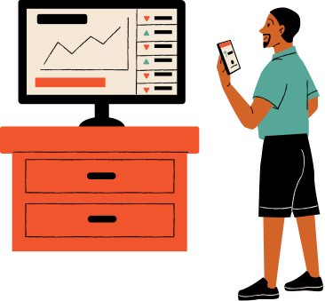
UI captures

Slide 6
demo
Track stock and gold investments
Show real-time portfolio value
Monitor monthly expenses
Display financial news
Why it's useful: One place to manage all your investments

Slide 7
Architecture
Frontend (HTML/CSS/JS) ↔ Backend (Node.js) ↔ Database (MySQL)

Slide 8
Tech Stack
Backend: Node.js, Express.js, MySQL
Frontend: Bootstrap, Chart.js, JavaScript
External Integrations: News API - Real-time financial news
Development Tools: Git - Version control and collaboration
npm - Package management

Slide 9
Conclusion
What we built:
8 REST API endpoints
Real-time portfolio tracking
Professional web interface
Mobile-friendly design

Slide 10

THANK YOU

